Slide 1
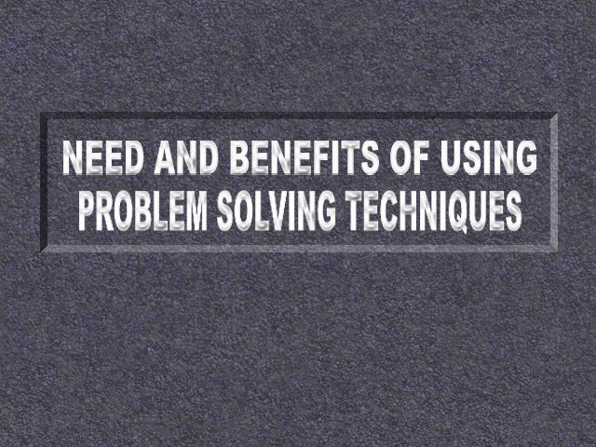

Slide 2
SQC
Introduction
SQC Techniques for Problem Solving

Slide 3


SQC
Today, SQC system is considered to be the most essential requirement for industry, whether it is manufacturing or service.

Slide 4
SQC
Dr W A Shewhart,
Dr W E Deming,
Dr J M Juran,
Dr Taguchi and
Dr K Ishikawa insist upon the effective use of this system to achieve excellence in quality.

Slide 5

SQC
Knowledge and practice of SQC system is therefore equally important for Quality Circle functions and Quality Improvement Team activities.

Slide 6
Use of SQC methods
These techniques started as a sporadic use in Japan. After the second world war due to intensive propagation by JUSE, they became a regular use in industries.
Dr K. Ishikawa divides statistical methods into three categories.

Slide 7
1. Elementary Statistical Methods (7-tools)
    Check-sheet (for data collection)
    Stratification
    Graph and Control Chart
    Pareto Chart
    Cause and Effect Diagram
    Histogram
    Scatter Diagram

Slide 8
    2. Intermediate Statistical Methods
    They are as follows:
A. Theory of sample surveys.
B. Statistical sampling inspection..
C. Various methods of making statistical estimates and tests.
D. Methods of utilising sensory tests.
E. Methods of design of experiments.
      These methods are taught to engineers and quality control personnel effectively in Japan.

Slide 9
3. Advanced Statistical Methods.
This constitutes a big list but the most important ones are
A. Advanced methods of design of experiments.
B. Multivariate analysis.
C. Various methods of operation research.

Slide 10

Advanced methods are used by technicians and engineers for optimisation of processes and securing reduction in costs.

Slide 11
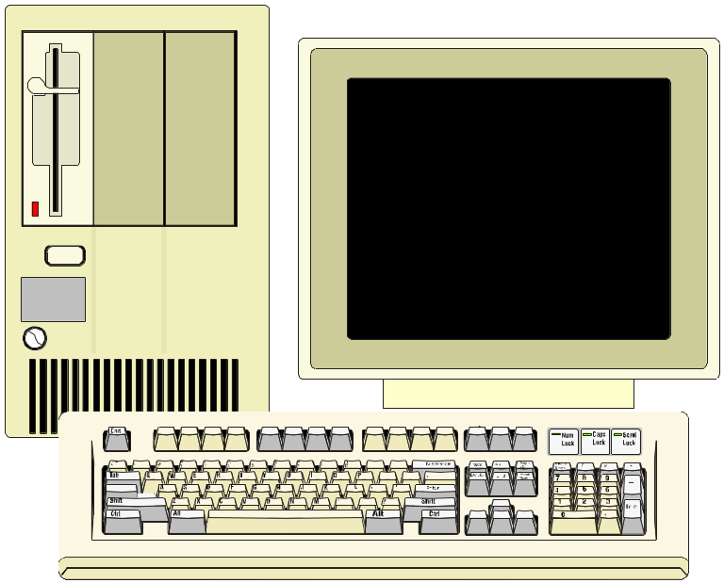
The use of all these three methods with computers wherever necessary, is reported to have played an important role in the quality development in Japanese industry.

Slide 12
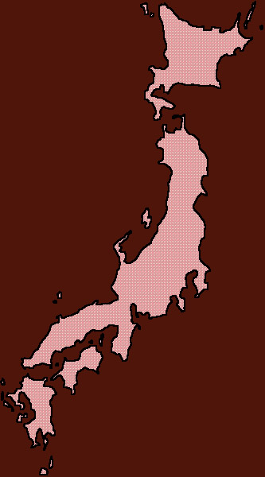
Statistical methods and technological advance
The use of statistical methods including the most sophisticated methods have become deeply rooted in Japan.

Slide 13

However, one must not forget the utility of simple seven tools. Unless a person masters these seven tools he cannot use the more sophisticated ones.

Slide 14
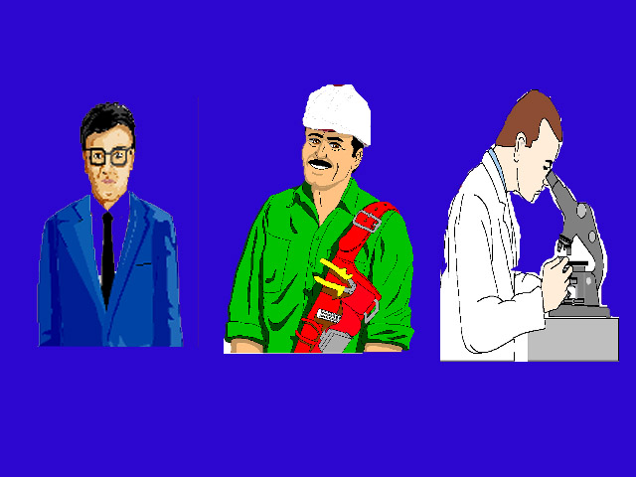
Elementary Statistical Methods
Dr K. Ishikawa considers them as seven indispensable tools to be used by everyone i.e. Company Managing Directors, Company Directors, Middle Management, Foreman and line workers.

Slide 15
Elementary Statistical Methods
It can be used anywhere. According to him 95% of all the problems in a company can be solved by these tools. In Japan these tools are used effectively by top management to line workers.

Slide 16
Along with these tools, facilitators and workers must also be trained in the following basic concepts for efficient functioning of Quality Circles.
a. The concept of quality.
b. Principles and implementation concerning ‘ management and improvement. '
c. Statistical way of thinking.

Slide 17
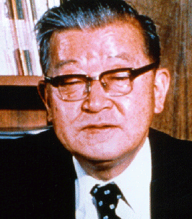
As Dr K Ishikawa says
“It was due to the use of this that the quality level has risen, reliability has risen, and cost has fallen. The key has been the dogged use of process analysis and quality analysis without fanfare for a long period of time.

Slide 18
This has brought about improvement in technology. Some contend that engineering
technology enhances technology and management technology maintains it. I do not subscribe to that claim. I cannot see any difference between engineering technology and management technology. The so-called control technique is part of proper technique.

Slide 19
One must utilize all the technology at his disposal to strive towards advancing quality
and efficiency. After the Second World War, Japan imported many new technologies from the West. Nowadays, Japan can export her technologies to the West as well. This is in large measure a result of the introduction of statistical quality control and the use of statistical analysis, process analysis and quality analysis.”

Slide 20
The late Prof. P.C. Mahalanobis, founder Director of Indian Statistical Institute, foresaw long ago the role of statistics in national development when he said "Statistics is the key technology of this century".
Keeping in mind what is stated by Prof. Mahalanobis and Dr. K Ishikawa, we strongly advocate knowledge and effective use of basic elementary statistical methods.

Slide 21
PROB. SOLV. TECH.
Flow Diagram
Brainstorming
After careful analysis, we have separated graphs and control charts as two separate tools and added to that two more tools viz. Flow diagram and Brainstorming. We call them Problem Solving Techniques.
Data Collection
Graphs
Stratification
Pareto Diagram
C & E Diagram
Scatter Diagram
Histogram
Control Charts

Slide 22
It is absolutely necessary that everyone from the Chairman, Managing Director to grass root level employees should learn and effectively make use of the ten problem solving tools.
We are listing here the tools along with their use.

Slide 23
Overview of the 10 Tools
Flow Diagram : To enable understanding of the process/flow and locate a problem.

Slide 24

Overview of the 10 Tools
Brainstorming : For generation of ideas in problem listing, listing of causes in problem analysis and for finding solutions.

Slide 25
Overview of the 10 Tools
SOLDER BATH TEMPERATURE
CHECKED BY Bajrang:
DATE :14.8.98
TAKE READING OF TEMPERATURE NEAREST TO DEGREE.
TIME
TEMP (
deg
.
cen
. )
TIME
TEMP (
deg
.
cen
. )
0800
60
1300
61
0900
62
1400
58
1000
59
1500
63
1100
58
1600
63
1200
59
1700
59
Data collection : To understand the magnitude of the problem and understand the problem. It is the foundation for statistical analysis.

Slide 26
Overview of the 10 Tools
BUDGET PROPOSAL
Graphs : Presentation of large amount of data in a cohesive manner in the pictorial form to enable better understanding of the data and the problem and also to comprehend the trend at a glance.

Slide 27
Overview of the 10 Tools
Stratification : To segregate data according to contributing sources (suppliers, machines, operators etc.).

Slide 28
Overview of the 10 Tools
Cumulative hours spent by warehouse
1800
workers on different jobs
Receival
1600
100
Dispatching
1400
80
Inspecting
1200
HOURS
1000
60
%
Tending
800
warehouse
600
40
Status reports
400
20
Inventory
200
taking
0
Dead stock
0
disposal
Nature of job
Pareto Chart : For identification/selection of major problem or area for improvement or control, to differentiate between vital and trivial problems.

Slide 29
Overview of the 10 Tools
    Cause & Effect Diagram : To map out all probable causes and relate the logical linking of causes to the problem to help narrow down to the cause or causes.

Slide 30
Overview of the 10 Tools
DEFECT LEVEL
LEVEL OF RESIN
Scatter Diagram : For examining relationship between two variables, nature and strength of relationship between process factors and product quality. In a way it is also a cause and effect approach between two variables.

Slide 31
Overview of the 10 Tools
30
25
142
144
20
146
FREQUENCY
148
15
150
152
10
154
5
156
158
0
WEIGHT OF SOAP (GMS)
Histogram : For study of process variation and assess process capability. This is an off-line quality control method.

Slide 32
Overview of the 10 Tools
UPPER CONTROL LIMIT
CENTRAL LINE
LOWER CONTROL LIMIT
Control Charts :For maintaining running control on a process. It is a tool for on-line quality control.

Slide 33

Procedures to be followed by Quality Circles in making use of these techniques.
Quality Circles meet regularly and periodically. The meeting is normally once a week for one hour.
The following steps outline the procedure along with reasons.

Slide 34
STEP 1
IDENTIFICATION OF WORK RELATED PROBLEM
METHOD
    a) Generate a list of problems using ‘BRAINSTORMING’
    b) Prioritize Problems using ‘A’ ‘B’ ‘C’ analysis.

Slide 35
‘C’ Category Problem
Management sanction may be needed in implementing the solution.
‘B’ Category Problem
Involvement of other departments is a necessity
‘A’ Category Problem
Minimum involvement of other departments in solving them

Slide 36

When Quality Circle movement is started in any organisation there will be a lot of interest and expectation for quick results from all. But this is basically a learning process.

Slide 37
After problems in an area are identified with the help of brainstorming, categorise them as mentioned above and concentrate on “A” category problems.

Slide 38
Since they call for actions from only the department or area concerned, analysis may be simple and will not call for use of many techniques. May be a simple data collection and discussion will be sufficient. Nevertheless, solving of such problems should also receive due recognition.

Slide 39
As the Quality Circle is new to the process and the infrastructure available in the organisation to train people at the initial stage is also limited, simple problems do not create any difficulty. They can be solved in two or three sittings.

Slide 40
This process will help Quality Circle members to gain confidence and will also keep their interest alive. The above learning process i.e. learning problem solving techniques can be gradual.

Slide 41


Once they exhaust the “A” category problems and when they move to “B” category, they will be more confident.
Now that we have completed all ‘A’ category problems ‘B’ category won’t be difficult to us.

Slide 42
“B” category will be having more difficult problems and hence, may call for more analysis and a little more time.
Yes but we need
training for some
more techniques

Slide 43
Because of their past achievements, other departments also will be willing to help them. Here they can learn some more techniques.
Both 'A' and 'B' category problems may not call for use of Milestone Chart.

Slide 44

By the time Quality Circles come to “C” category they would have been seasoned QC members and learning all the Problem Solving Techniques would not be difficult.
Moreover, their track record will help in getting the management support quickly.
PROBLEMS ? WE HAVE NO PROBLEM IN SOLVING THEM

Slide 45
By hurrying up and selecting major problems in the initial stages, they may get bogged down and eventually QCs will lose interest and end up as non-performers.

Slide 46
STEP 2
SELECTION OF PROBLEM
Let us assume that they have finished with all smaller problems and have taken up a major problem.
METHOD
    a) ‘PARETO ANALYSIS’ or ‘RATING ’ based on past data or system.
    b) Register the selected problem with the coordinating agency.

Slide 47
After selection of a problem, Quality Circle at this stage should use a Milestone Chart or a Gantt Chart for planning and to work within a time bound frame.
These Charts will help in comparing the actual time taken compared to the planned time schedule.

Slide 48
MILESTONE CHART
Quality Circle Activity Planning
PROJECT STUDY PLANNING IS AN EFFECTIVE METHOD BY WHICH QUALITY CIRCLE MEMBERS ATTAIN THE SKILL TO PLAN THEIR ACTIVITIES AND EFFECTIVE TIME MANAGMENT
Quality Circle Name Department Manager Facilitator Members’ Name
Project Reason for selection
Project No. Date of beginning Date of completion
Meeting Day Time No. of projects completed
No. Activity Week 1 2 3 4 5 6 7 8 9 10 11 12 13 14 15 16 17 18 19 20 21 22 23 24 Target Actual
1. Defining the problem
2. Analyzing the problem
3. Identifying the causes
4. Finding out the root cause
5. Data analysis
6. Developing solution
7. Foreseeing possible resistance
8. Trial implementation and checking performance
9. Regular Implementation
10. Follow-up/Review

Slide 49
The benefit of using such a system is multi-fold.
    a. Quality Circle members are able to have a clarity about the steps involved in problem solving.
    b. They will be able to plan ahead themselves and foresee possible obstacles in the process.
    c. By studying the difference between estimated and actual time, they will improve their estimation or planning capability.

Slide 50
STEP 3
DEFINE THE PROBLEM
METHOD
By using a ‘FLOW DIAGRAM’. Use of flow diagram helps in having clarity of the problem by all members. There may be some members who are not aware of the entire process.

Slide 51

STEP 3
This will help them to understand and also would be a great help in promoting the case study to others. A flow diagram helps one to have a ‘ armchair journey’ into a process cycle and to locate the problem area.
Other technique which can be used in defining the problem
Brainstorming

Slide 52
STEP 4
ANALYSE THE PROBLEM
METHOD
‘DATA COLLECTION’ on the problem on all possible aspects.
Analysis is very essential. There may be certain dimensions of the problem which are not understood by all. A discussion will help in pooling up ideas.

Slide 53
STEP 5
IDENTIFICATION OF CAUSES
METHOD
BRAINSTORMING first and making a CAUSE and EFFECT DIAGRAM, logically linking the causes to the main contributory factors.
Identification of causes is not only what we think as cause for that situation but also all possible causes. What is expected is a total analysis and presentation in the form of Cause and Effect diagram. It needs to be studied and discussed in detail.

Slide 54
STEP 6
FINDING OUT THE ROOT CAUSES
METHOD
Identifying the main causes in ‘CAUSE and EFFECT DIAGRAM’ by ‘DATA COLLECTION’ and discussion.
Root cause has to be established with the help of data. In case, for any reason, it is not possible to collect data it may be established based on experience. But experience has also to be quantified.

Slide 55

STEP 7
DATA ANALYSIS
METHOD
Using techniques like LINE GRAPH, BAR GRAPH, PIE GRAPH, AREA GRAPH, HISTOGRAM, STRATIFICATION, SCATTER DIAGRAM etc. would help easy comprehension and make comparison possible.

Slide 56

STEP 7
Before proceeding with remedial measures, data has to be analysed and discussed for possible solutions to be arrived at.
Once again discussing and selecting the best solution among the listed ones has to be done. Brain Storming will be an useful tool at the stage of analysis.

Slide 57
STEP 8
DEVELOPING SOLUTION
METHOD
‘BRAINSTORMING’

Slide 58

STEP 9
FORESEEING POSSIBLE RESISTENCE
METHOD
‘BRAINSTORMING’
Identifying the probable constraints and finding ways to overcome them.

Slide 59

STEP 9
Make a presentation to all involved with the solution i.e. Dept. Head, Facilitator, other officials, and nonmembers involved with the implementation. Discuss and evaluate a system for implementation.

Slide 60

STEP 9
We should carefully analyse the acceptance line and try to foresee possible resistance. Changes are not easy to implement unless and until it is acceptable to the people involved.

Slide 61
STEP 10
TRIAL IMPLEMENTATION AND CHECK PERFORMANCE
METHOD
Data collection after implementation compared with the data collected before solving the problem. Collect fresh data using control chart and watch process trends. Analyse the result, discuss and incorporate the changes needed.

Slide 62
STEP 11
REGULAR IMPLEMENTATION
Once validity is checked and improvement observed with data, regular implementation can be effected.
Incorporate the suggestions in the working system or work instruction sheets (Process cards.)

Slide 63
STEP 12
FOLLOW UP / REVIEW
METHOD
Implement evaluation procedure, use Control Chart, have six monthly report for evaluation.
Make modifications if necessary.

Slide 64
Now let us look into the steps needed to be taken before Problem Solving.

Slide 65

Prepared by
G. Vijaykumar

Slide 66


